Slide 1


CA22123 EU-MACE: European Materials Acceleration Center for Energy MC1 discussions
Sawako Nakamae (Action Chair candidate)
Commissariat à l’Energie Atomique et aux Energies Alternatives

Slide 2
Outline
Action Structure proposal (Tasks, subtasks, committees, etc.)
Leadership positions proposal
Core Group and mandates proposal
Proposal for WBP (Grant Period goals, budget allocation to activities)
Next MC Meeting (dates/locations) proposal
EU-MACE other operational rules: proposal

Slide 3
General Action structure
Budget proposition to MC
Action Chair
MANAGEMENT COMMITTEE (MC)
GRANT HOLDER (GH)
Vice-Chair
GH scientific rep.
WG1
WG2
WG3
WG4
WG5
WG leaders & WG core group
HORIZONTAL GROUPS
Grant Awarding Coordinator
Science Comm. Coordinator
Transversal Task leaders & Task core group
Nearly ALL Tasks are WG-transversal
WG leaders, Task leaders and Core group members all overlap, interchange and change

Slide 4
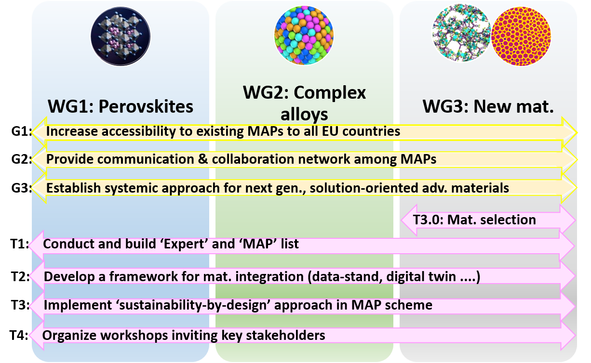
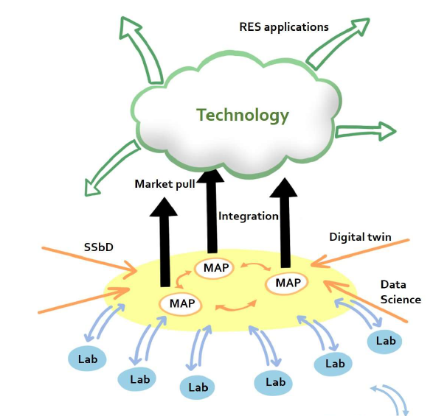
Action structure proposal
All tasks are ‘transversal’ except
New Material Selection
Materials WGs:
Notes:
by identifying common ground and building on areas of overlap
between digital and material competencies (horizontal link): Knowledge sharing and cooperation
between existing SDLs/MAPs, and inclusion of key expertise for maximizing their operation efficiency
and streamlining device integration process.
by identifying common ground and building on areas of overlap
between digital and material competencies (horizontal link): Knowledge sharing and cooperation
between existing SDLs/MAPs, and inclusion of key expertise for maximizing their operation efficiency
and streamlining device integration process.
Upstream integration of advanced materials into functioning devices and scaleup
production taking into account not only the performance (efficiency) requirements, but also the
techno-economic issues, socio-economic impacts and regulatory bodies.

Slide 5
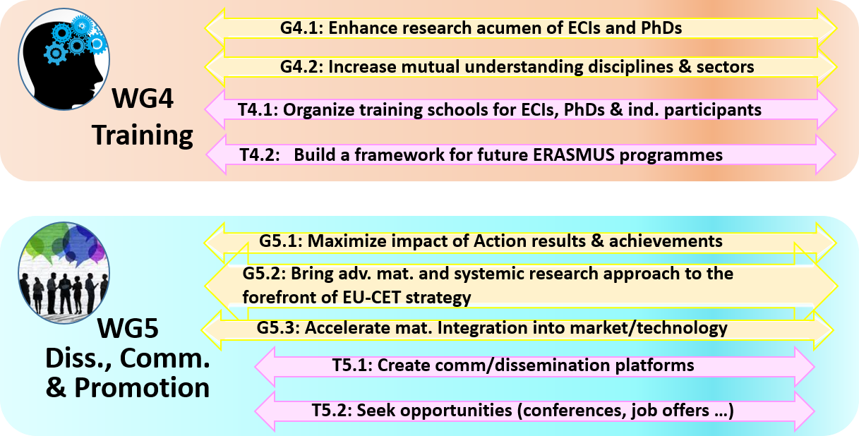
Action structure proposal
EU-MACE is run by
TASK Core Groups
that include:
MC & GA Coord + Comm Coord
All MC members should be active in Task Core Groups
Core Group members & leaders can and should vary (e.g. workshops/schools)
Notes:
by identifying common ground and building on areas of overlap
between digital and material competencies (horizontal link): Knowledge sharing and cooperation
between existing SDLs/MAPs, and inclusion of key expertise for maximizing their operation efficiency
and streamlining device integration process.
by identifying common ground and building on areas of overlap
between digital and material competencies (horizontal link): Knowledge sharing and cooperation
between existing SDLs/MAPs, and inclusion of key expertise for maximizing their operation efficiency
and streamlining device integration process.
Upstream integration of advanced materials into functioning devices and scaleup
production taking into account not only the performance (efficiency) requirements, but also the
techno-economic issues, socio-economic impacts and regulatory bodies.

Slide 6
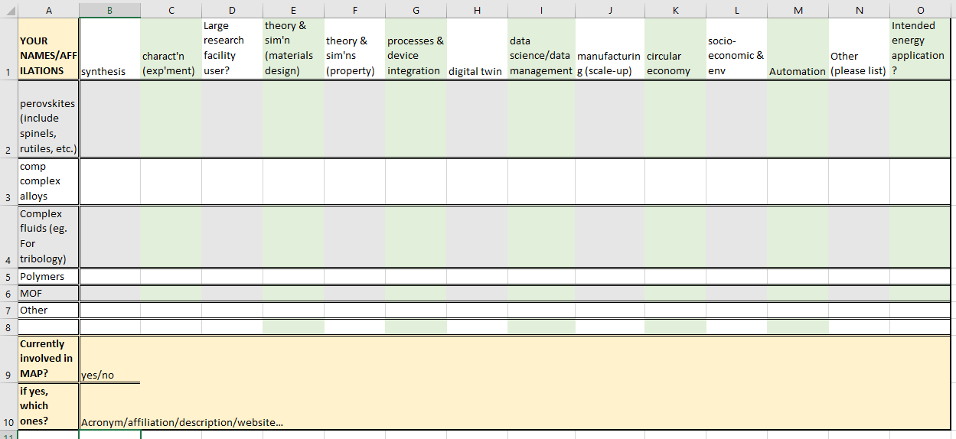
Action structure proposal
Tasks – coordinated by Core Task group members: Example
Expert and MAP list :
Among EU-MACE
Non-participant entities and researchers
Task Core Group will
Collect information (how? When? …)
Analyze
Identify
Summarize
Notes:
by identifying common ground and building on areas of overlap
between digital and material competencies (horizontal link): Knowledge sharing and cooperation
between existing SDLs/MAPs, and inclusion of key expertise for maximizing their operation efficiency
and streamlining device integration process.
by identifying common ground and building on areas of overlap
between digital and material competencies (horizontal link): Knowledge sharing and cooperation
between existing SDLs/MAPs, and inclusion of key expertise for maximizing their operation efficiency
and streamlining device integration process.
Upstream integration of advanced materials into functioning devices and scaleup
production taking into account not only the performance (efficiency) requirements, but also the
techno-economic issues, socio-economic impacts and regulatory bodies.

Slide 7
Leadership positions: proposal
Chair | Sawako Nakamae | MC | France (CEA)
Vice Chair | Monica Fabrizio | MC | Italy (CNR)
GH SR | Sawako Nakamae | MC | France (CEA)
Grant Awarding Coord. | Holger Ihssen | MC | Germany (KIT)
Sci. Comm. Coordinator | Ivan Matejak | MC | Belgium (EERA)
WG 1 Leader | Helge Stein | MC | Germany (TUM)
WG 2 Leader | Jaroslaw Jasinkski | MC | Poland (NCJB)
WG 3 leader | Kourosh Malek | - | Germany (FZJ)
WG 4 leader | David Lacroix | MC | France (U Lorraine)
WG 5 leader | Ivan Matejak | MC | Belgium (EERA)
Starting members =
Original secondary proposers
WG leaders are part of Task Core Groups
WG leadership mandate (rotate among Core Group) @M12, M36
Increase YRI and ITC
Gender balance

Slide 8
Leadership positions proposal – Task Core Group
Identified from secondary proposers
 | Task | Core Group members
1 | Expert & MAP list | Helge Stein, S. Erlinger, J. Vieten, A. Bieberle, M. Rabung, J. Jasinski, D. Ripamonti, F. Balbaud, L. Malerba
2 | Materials integration | Rafael M. Garcia, K. Malek, H. Stein, J. Pakarinen, J. Vieten? (need industrial participation)
3 | Sustainability | Eleonora Annunziata, G. Campana, M Fabrizio, A. Sciullo
4 | Workshop (1st) | S. Nakamae, R. Mayo Garcia, M. Fabrizio, D. Lacroix, J. Pakarinen, M. Celino
5 | Training school | Theodora Kyratzi, D. Lacroix, E. Annunziata, G. Miladenovic, H. Stein, K. Malek
6 | ERASMUS+ incub | David Lacroix, T. Kyratzi, A. P. Gonçalves (+ many applicants expected to join)
7 | Dissemination/Comm | Ivan Matejak (at least 2 among applicants identified)
8 | Grant Award coord | Holger Ihssen, T. Lekesiz, Antonio P. Gonçalves (need ppl with experience in COST)
9 | New Mat selection | Anja Bieberle, T. Lekesiz, A. P. Sanjuan (+ many applicants expected to join)
10 | Application selection | S. Nakamae, M. Fabrizio + need 3 more MCs

Slide 9
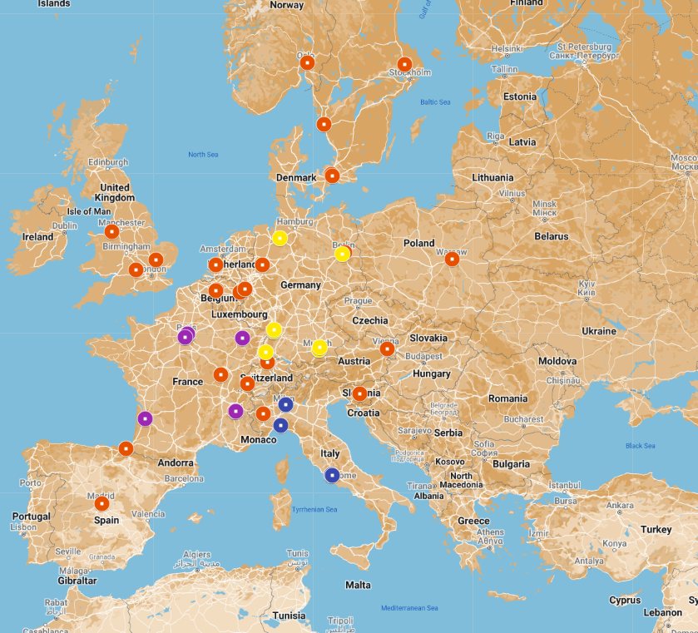

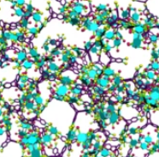

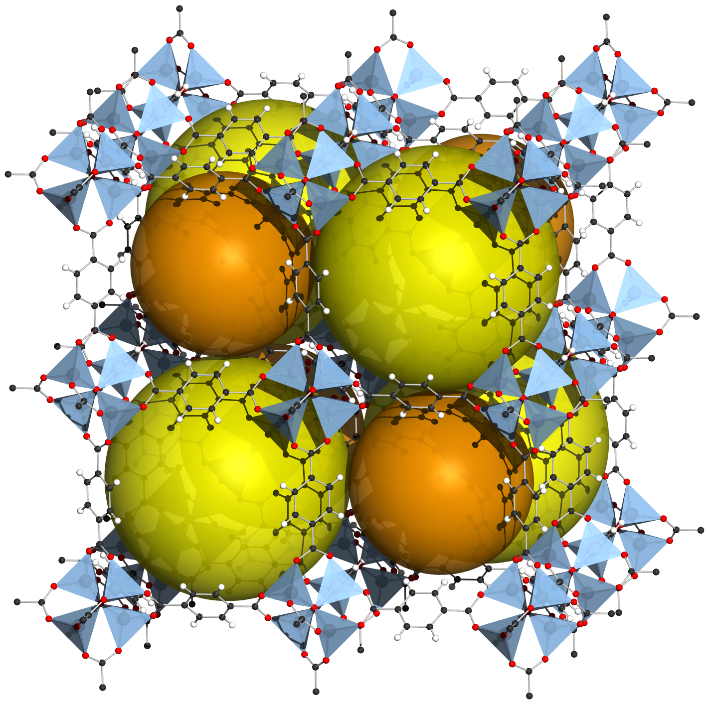


Work and Budget Proposal: 1st Grant Period Goals (1/11/2023-31/10/2024)
2nd Q
1st Q 2024
Website, logo, SN platforms
Experts & MAPs list (to be updated yearly) ➔
Joint workshop organization (Materials integration)
New materials selection
Training school topics - planning
Strategies for incorporating SSbD tools into MAPs
January 2024
3rd – 4th Q
4th Q
(MC 2)

Slide 10
1st year Budget plan proposition: (total 125 k€)
Activity type | Amount (€) | Note
MC meetings | 44000 | MC2 with WS1, Rome (max traveil reimb. limit) MC3 with WG3/WG4 meetings
Workshop 1 (Mat Integ.) LOS + Invitation | 16000 | 6K LOS + 10K Invitation (oral presentations)
WG3/WG4 meeting LOS + Invitation | 8000 | 2K LOS + 6K Invitation (core members)
STSM | 24000 | Max 4k/mission (n° of supported mission)
ITC Conference Grant | 4000 | Max amount to be decided
Dissem. Comm | 5600 | Conference prez (2k) & OA (3600€)
Web/logo/SNS | 6000 | (total 12K for 4 years)
OERSA | 1000 | Bank charges, shipping
Subtotal | 108600
FSAC (GH management) | 16304
Total | 124904
LOS: local organization support
No VN support
provided
Notes:
Inclusive: for the broadest EU research communities
Knowledge base of the participants: data, experimental & numerical techniques; theories, etc.
Accelerated device integration: Knowledge sharing and cooperation
between existing SDLs/MAPs, and inclusion of key expertise for maximizing their operation efficiency
and streamlining device integration process.
Market pull, Societal pull: taking into account not only the performance (efficiency) requirements, but also the
techno-economic issues, socio-economic impacts and regulatory bodies.

Slide 11
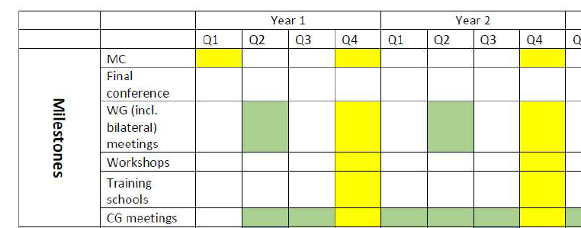

Meetings/workshops/schools
A few words on:
Network expansion opportunity
For EU-MACE
For individual researchers
Research & Researc policy
Joint workshop on: Digitalization and automation boost energy materials research
When: 23-24 or 24-25/01/2024 (1.5 days with 0.5 day of MC meeting)
With whom?: European Energy Research Alliance (DfE and AMPEA)
Size (estimate): total 25 presentations participants (~10-15 from EU-MACE)

Slide 12
Delegation of powers to Core Group - proposal
To expedite the decision making process without necessitating ad-hoc MC meetings​
Category | Decisions | Delegation
Event organization | Selection of invitees, reimbursed participants and trainers | Event Core Group* and the local organization support
 | Scientific program definition
 | Logistic decisions: venue, schedule, social events while respecting the allocated LOS budget
STSM & ITC conf. grant | Selection of grant recipients, the number of grants and the allocation/grant | Grant Award coordination core group
Budget & Admin. | Reallocation of unspent budget (< 10 k€) for activities already listed in the WBP or new ones (COST eligibility rules apply) | Concerned Core Task/WG Group + Action Chair + Vice Chair + Grant Holder Management
 | Cancellation of un-answered invitation in the period agreed by the MC (10 calendar days)
*Core-group members vary according to the event topic ​
Notes:
Collaborations from several communities and countries
Opportunities for newly developed advanced materials
Continued growth = (further education) among senior investigators, increase the acceptance-rate of ‘new’ methodologies and collaboration schemes,
Education program for pre-PhD’s prior to settling their PhD research agenda
Decision makers: private and public

Slide 13
Travel expense limitation- proposal
To increase the number of invitations and conference attendances​
Category | Decisions | Note
Travel expense | Up to 450€ for < 1200km (near-EU contries) | Participants must make effort to reduce the travel cost
 | Up to 700€ for > 1200km (far-EU countries)
 | Case-by-case for non-EU countries
Daily allowance | max 1 night before and 1 night after the event attendance | Applies to all travels
Let’s be careful!
Notes:
Collaborations from several communities and countries
Opportunities for newly developed advanced materials
Continued growth = (further education) among senior investigators, increase the acceptance-rate of ‘new’ methodologies and collaboration schemes,
Education program for pre-PhD’s prior to settling their PhD research agenda
Decision makers: private and public

Slide 14
Action application admission criteria - proposition
Some confusion in the applicants ‘motivations’ and ‘proposed contributions’
Our Goal
Systemic approach built around MAPs for accelerated integration and scale-up production of advanced functional materials for low-carbon technologies.
MAP
Do you want to or can you become part of the ecosystem by:
Learning or teaching how MAPs work ?
Including automated materials research platforms in your research activities?
Connecting (their) MAPs with other platforms & structures?
Contributing to improve MAPs (digital twin, integration, data management, inter-MAP knowledge sharing, implementing SSbD tools, or other aspects that can be beneficial)?
Planning to build future MAPs for a new class of materials internationally, nationally and/or institutionally ?
Disseminating our Action ?
Any other contributions useful for EU-MACE?
Core Group for examining applications: (Action Chair, Vice Chair + 3 MC members)
Notes:
There are many applicants whom I suspect are serial COST-Action applicants; i.e., they join in order to benefit from ITC conference grant, STSM grant, or attend workshops for free (which is not an automatic condition). These people do a simple keyword search (such as perovskites, energy materials, alloys, new materials, etc.) and describe their expertise, then express their interest in expanding their collaboration network. Although COST Action is a network building scheme, the participants should understand the purpose and the goal of EU-MACE. Namely, we will build an example systemic materials research ecosystem around MAPs. So in my opinion, it is not appropriate to accept those who have not included their interest in: learning how MAPs work, wanting to be include the automated materials research platforms in their research activities, connecting (their) MAPs with other platforms, contributing to improve MAPs (digital twin, integration, data management, inter-MAP knowledge sharing, implementing SSbD tools) or building future MAPs for a new class of materials internationally, nationally and/or institutionally.

Slide 15
Next steps
Budget finalization: very soon
Task 10: WG applicant examination, decision, notification: by January 3, 2024
Task 2 & 4 Workshop: 1st meeting with EERA JPs (January 24-25, 2024)
Task 7 (Dissemination/comm): website/logo/SN
Task 1 core group (Exp & MAP list): COST action café summary (must decide on the methodology before next MC meeting)
Task 9 (New materials): COST Action café summary
Task 5 & 3 (Sustainability & Training school): COST Action Café summary
Tasks 6 & 8 (ERASMUS, Grant Award) : topic for next MC meeting?
Will need MC members & secondary proposers to become Core Group members and lead ➔ signup sheet available!

Slide 16
Lastly, from evaluation…
…. the proposal fails at identifying the added value that EU-MACE will bring as compared to these already active initiatives
EU-MACE’s network will naturally prove its added value

